Slide 1

Foundations of Planning

Slide 2

Planning
  Managerial function that involves:
    Defining the organization’s goals
    Establishing an overall strategy for achieving those goals
    Developing a comprehensive set of plans to integrate and coordinate organizational work
  Types of planning
    Informal: not written down, short-term focus; specific to an organizational unit
    Formal: written, specific, and long-term focus, involves shared goals for the organization
Notes:
Planning involves defining the organization’s goals, establishing an overall strategy for achieving these goals, and developing a comprehensive set of plans to integrate and coordinate organizational work. The term planning as used in this chapter refers to formal planning.

Slide 3


  Provides direction
  Reduces uncertainty
  Minimizes waste and redundancy
  Sets the standards for controlling
Notes:
Planning is important and serves many significant purposes:
1. Planning gives direction to the organization.
2. Planning reduces the impact of change.
3. Planning reduces overlapping and wasteful activities.
4. Planning establishes the goals or standards that are used in controlling.

Slide 4

The Relationship Between Planning and Performance
  Formal planning is associated with:
    Higher profits and returns on assets
    Other positive financial results
  The quality of planning and implementation affects performance more than the extent of planning
  The external environment can reduce the impact of planning on performance
  Formal planning must be used for several years before planning begins to affect performance
Notes:
Research has shown we cannot assume organizations with formal planning processes always outperform those organizations that don’t have formal planning processes.
1. Generally speaking, however, formal planning is associated with positive financial results.

Slide 5


Elements of Planning
  Goals (also objectives)
    Desired outcomes for individuals, groups, or entire organizations
    Provide direction and performance evaluation criteria
  Plans
    Documents that outline how goals are to be accomplished
    Describe how resources are to be allocated and establish activity schedules
Notes:
Planning is often called the primary management function because it establishes the basis for all other functions. Planning involves two important elements: goals and plans.
Goals are desired outcomes for individuals, groups, or entire organizations. Goals are objectives—the two terms are used interchangeably.
Plans are documents that outline how goals are going to be met and that typically describe resource allocations, schedules, and other necessary actions to accomplish the goals.

Slide 6

Traditional Goal Setting
  Broad goals are set at the top of the organization
  Goals are then broken into subgoals for each organizational level
  Goals are intended to direct, guide, and constrain from above
  Goals lose clarity and focus as lower-level managers attempt to interpret and define the goals for their areas of responsibility
Notes:
Goals can be established through a process of traditional goal setting or through management by objectives:
1. Traditional goal setting is defined as the process whereby goals are set at the top of the organization and then broken down into subgoals for each level in an organization.
a. Top managers are assumed to know what’s best because they see the “big picture.”
b. These goals are also often largely nonoperational.
c. Specificity is achieved as each manager applies his or her own set of interpretations and biases.
d. However, what often results is that objectives lose clarity and unity as they move from top to bottom (see Exhibit 6.1).

Slide 7

”
We need to improve the
company
’
s performance.
”
”
I want to see a
significant improvement
Top
in this division
’
s profits.
”
Management
’
s
Objective
Division
”
Increase profits
regardless of the means.
”
Manager
’
s Objective
”
Don
’
t worry about
Department
quality; just work fast.
”
Manager
’
s Objective
Individual
Employee
’
s Objective
Notes:
Traditional goal setting is defined as the process whereby goals are set at the top of the organization and then broken down into subgoals for each level in an organization.

Slide 8
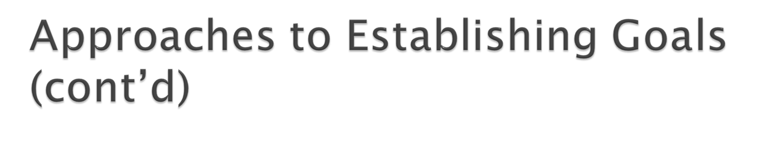
Maintaining the Hierarchy of Goals
  Means-Ends Chain
    The integrated network of goals that results from establishing a clearly defined hierarchy of organizational goals
    Achievement of lower-level goals is the means by which to reach higher-level goals (ends)
Notes:
When the hierarchy of objectives is clearly defined, it forms an integrated means-end chain in which higher-level objectives are linked to lower-level objectives. These lower-level objectives serve as the means for the accomplishment of the higher-level objectives. And the goals at the lower levels (means) must be achieved in order to reach the goals at the next level (ends).

Slide 9
Management By Objectives (MBO)
  Specific performance goals are jointly determined by employees and managers.
  Progress toward accomplishing goals is periodically reviewed.
  Rewards are allocated on the basis of progress toward the goals.
  Key elements of MBO:
    Goal specificity, participative decision making, an explicit performance/evaluation period, feedback
Notes:
Management by objectives (MBO) is defined as a system in which specific performance goals are jointly determined by employees and their managers, progress toward accomplishing these goals is periodically reviewed, and rewards are allocated on the basis of this progress.
A. MBO was first described by Peter Drucker and consists of four elements:
1. Goal specificity
2. Participative decision making
3. Explicit time period
4. Performance feedback
B. MBO makes objectives operational through the process by which they cascade down through the organization.
C. Exhibit 6.2 lists the steps in a typical MBO program.

Slide 10

Jointly Set Objectives
Develop Action Plans
Review Objectives and
Give Rewards for
to Achieve Objectives
Provide Feedback
Achieved Objectives
Overall objectives
Managers and
and strategies of
employees work on
organization
action plans together
Objectives allocated to
Action plans
divisional and
implemented
departmental units
Specific objectives
collaboratively set
with employees
Notes:
Exhibit 6.2 lists the steps in a typical MBO program.

Slide 11

Reason for MBO Success
  Top management commitment and involvement
Potential Problems with MBO Programs
  Not as effective in dynamic environments that require constant resetting of goals
  Overemphasis on individual accomplishment may create problems with teamwork
  Allowing the MBO program to become an annual paperwork shuffle
Notes:
Studies of actual MBO programs confirm that MBO can increase employee performance and organizational productivity. However, top-management commitment and involvement are important contributions to the success of an MBO program.

Slide 12

Written in terms of outcomes rather than actions
Measurable and quantifiable
Clear time frame
Challenging yet attainable
Written down
Communicated to all necessary organizational members
Notes:
Characteristics of Well-Designed Goals (see Exhibit 6.3)
a. Written in terms of outcomes
b. Measurable and quantifiable
c. Clear as to a time frame
d. Challenging, but attainable
e. Written down
f. Communicated to all organizational members

Slide 13

Review the organization’s mission statement
  Do goals reflect the mission?
Evaluate available resources
  Are resources sufficient to accomplish the mission?
Determine goals individually or with others
  Are goals specific, measurable, and timely?
Write down the goals and communicate them
  Is everybody on the same page?
Review results and whether goals are being met
  What changes are needed in mission, resources, or goals?
Notes:
Steps in Goals Setting
a. Review the organization’s mission. Goals should reflect what the mission statement says.
b. Evaluate available resources.
c. Determine individually, or with input from others, the goals.
d. Write down the goals and communicate them to all who need to know.
e. Review results and whether goals are being met.

Slide 14

Types of
Plans
Breadth
Time Frame
Specificity
Frequency of Use
Strategic
Long term
Directional
Single use
•
Should we expand
into overseas
markets?
•
Should we develop
new products?
•
How large would we
like the company to
be in five years?
Operational
Short term
Specific
Standing
•
Should we order new
equipment to produce
our number-one
product more
•
efficiently?
How many extra
employees should we
hire for the year-end
•
sales rush?
How can we improve
quality control on the
production line?
Notes:
Types of Plans: The most popular ways to describe organizational plans are pictured in Exhibit 6.4, Types of Plans. The characteristics include:
A. Breadth (strategic vs. operational)
B. Time frame (short term vs. long term)
C. Specificity (directional vs. specific)
D. Frequency of use (single use vs. standing)

Slide 15

BREADTH
Strategic Plans
  Apply to the entire organization
  Establish the organization’s overall goals
  Seek to position the organization in terms of its environment
  Cover extended periods of time
Operational Plans
  Specify the details of how the overall goals are to be achieved
  Cover short time period
Notes:
A. Breadth (strategic vs. operational)
1. Strategic plans are long term, directional, and single use. They apply to the entire organization, establish the organization’s overall goals, and seek to position the organization in terms of its environment.
2. Operational plans are short term, specific, and standing. They specify the details of how the overall goals are to be achieved.

Slide 16

TIME FRAME
Long-Term Plans
  Time frames extending beyond three years
Short-Term Plans
  Time frames of one year or less
SPECIFICITY
Specific Plans
  Clearly defined and leave no room for interpretation
Directional Plans
  Flexible plans that set out general guidelines, provide focus, yet allow discretion in implementation
Notes:
B. Time Frame (short term vs. long term)
We define long-term plans as those with a time frame beyond three years. We define short-term plans as those with a time frame of one year or less.
C. Specificity (directional vs. specific)
1. Specific plans are plans that are clearly defined and that leave no room for interpretation. They have clearly defined objectives. There’s no ambiguity and no problem with misunderstanding.
2. Directional plans are flexible plans that set out general guidelines. They provide focus but don’t lock managers into specific goals or courses of action. (Exhibit 6.5 illustrates how specific and directional planning differ, with the directional plan indicating only the intent to get from A to B and the specific plan identifying the exact route that one would take to go from A to B.)

Slide 17
FREQUENCY OF USE
Single-use Plan
  A one-time plan specifically designed to meet the needs of a unique situation
Standing Plans
  Ongoing plans that provide guidance for activities performed repeatedly
Notes:
D. Frequency of Use (single use vs. standing)
1. A single-use plan is a one-time plan specifically designed to meet the needs of a unique situation.
2. Standing plans are ongoing plans that provide guidance for activities performed repeatedly. Standing plans include policies, rules, and procedures.

Slide 18

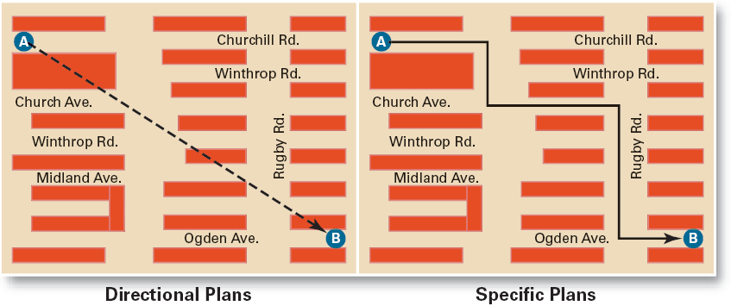
Notes:
Exhibit 6.5 illustrates how specific and directional planning differ, with the directional plan indicating only the intent to get from A to B and the specific plan identifying the exact route that one would take to go from A to B.

Slide 19

Contingency Factors in Planning
  Manager’s level in the organization
    Strategic plans at higher levels
    Operational plans at lower levels
  Degree of environmental uncertainty
    Stable environment: specific plans
    Dynamic environment: specific but flexible plans
  Length of future commitments
    Current plans affecting future commitments must be sufficiently long-term to meet the commitments
Notes:
Factors that affect planning:
A. Manager’s level in the organization (see Exhibit 6.6). Operational planning usually dominates the planning activities of lower-level managers. As managers move up through the levels of the organization, their planning becomes more strategy oriented.
B. Degree of environmental uncertainty. The greater the environmental uncertainty, the more plans should be directional and emphasis placed on the short term.
1. When uncertainty is high, plans should be specific, but flexible.
2. Managers must be prepared to rework and amend plans, or even to abandon their plans.
C. Time frame of plans.
1. Commitment concept means that plans should extend far enough to meet those commitments made when the plans were developed.
2. Planning for too long or for too short a time period is inefficient and ineffective.

Slide 20

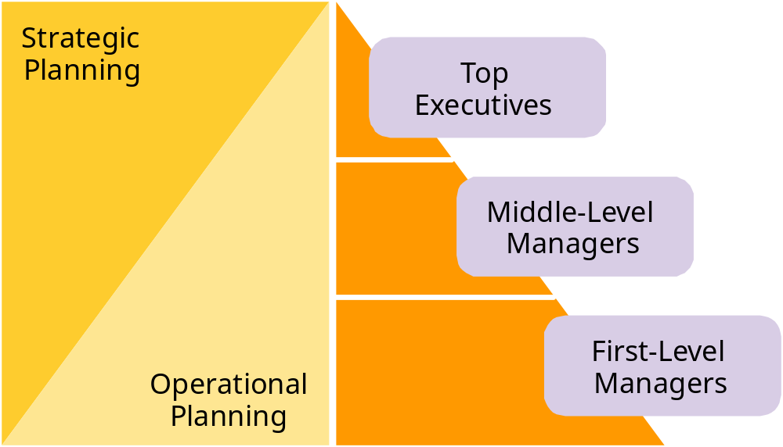
Notes:
The level of a manager determines whether he or she will be more involved in operational planning or more involved in strategic planning.

Slide 21

Establishing a formal planning department
  A group of planning specialists who help managers write organizational plans
  Planning is a function of management; it should never become the sole responsibility of planners
Involving organizational members in the process
  Plans are developed by members of organizational units at various levels and then coordinated with other units across the organization
Notes:
A. Traditional Approach—planning was done entirely by top-level managers who were often assisted by a formal planning department.
B. Organizational Member Involvement—plans aren’t handed down from one level to the next, but are developed at the various levels to meet specific needs.

Slide 22

Criticisms of Planning
  Planning may create rigidity
  Plans cannot be developed for dynamic environments
  Formal plans cannot replace intuition and creativity
  Planning focuses managers’ attention on today’s competition, not tomorrow’s survival
  Formal planning reinforces today’s success, which may lead to tomorrow’s failure
Notes:
Although planning is an important and popular managerial function, five major arguments have been directed against planning.
1. Planning may create rigidity. Formal planning may “lock” an organization into specific goals and specific timetables that were established under certain environmental conditions. If the environment changes, managers may believe they’re locked into the current plans.
2. Plans can’t be developed for a dynamic environment. Managing under chaotic environmental conditions requires flexibility, and that may mean not being tied to formal plans.
3. Formal plans can’t replace intuition and creativity. The formal planning process may emphasize the mechanics and routines of planning and ignore important aspects.
4. Planning focuses managers’ attention on today’s competition, not on tomorrow’s survival. Formal planning has a tendency to make managers focus on today’s realities, not on tomorrow’s possibilities.
5. Formal planning reinforces success, which may lead to failure. Because the "plans" have led to success, there may be reluctance on the part of managers to change or discard previously successful plans. "If it ain’t broke, why fix it?"

Slide 23
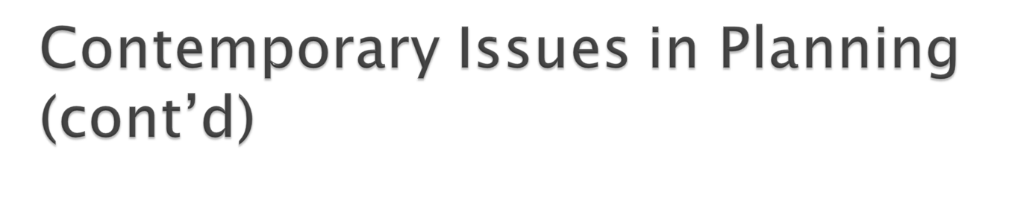
Effective Planning in Dynamic Environments
  Develop plans that are specific but flexible
  Understand that planning is an ongoing process
  Change plans when conditions warrant
  Persistence in planning eventually pays off
  Flatten the organizational hierarchy to foster the development of planning skills at all organizational levels
Notes:
The external environment is constantly changing.
1. Managers want to develop plans that are specific, but flexible.
2. Managers must recognize that planning is an ongoing process, and they should be willing to change directions if environmental conditions warrant.
3. Flexibility is particularly important.
4. Managers must stay alert to environmental changes that could impact the effective implementation of plans, and make changes as needed.

